Slide 1
Language Modeling
Unit 2

Slide 2
Unit Topics
Advanced Smoothing Models
Computational Morphology
Finite State Methods for Morphology,
Introduction to POS Tagging,
Hidden Markov Models for POS Tagging.
Viterbi Decoding for HMM,
Parameter Learning. Baum Welch Algorithm,
Maximum Entropy Models-1,
Maximum Entropy Models-II
Conditional Random Fields.

Slide 3
Language Modelling: Advanced Smoothing Models
ls
Week 3: Lecture 1
3 / 18

Slide 4
Advanced smoothing algorithms
Some Examples
Good-Turing Kneser-Ney
Good-Turing: Basic Intuition
Use the count of things we have see once
to help estimate the count of things we have never seen
ls
Week 3: Lecture 1
2 / 18

Slide 5
N_{c}: Frequency of frequency c
Example Sentences
<s>I am here </s>
<s>who am I </s>
<s>I would like </s>
Computing N_{c}
I | 3
am | 2
here | 1 | N₁ = 4
who | 1 | N₂ = 1
would | 1 | N₃ = 1
like | 1
ls
Week 3: Lecture 1
3 / 18

Slide 6
Good Turing Estimation
Idea
Reallocate the probability mass of n−grams that occur r + 1 times in the training data to the n−grams that occur r times
In particular, reallocate the probability mass of n−grams that were seen once to the n−grams that were never seen
Adjusted count
For each count c, an adjusted count c∗ is computed as:
_{c∗ =} (c + 1)N_{c+1}
N_{c}
where N_{c} is the number of n−grams seen exactly c times
ls
Week 3: Lecture 1
4 / 18

Slide 7
Good Turing Estimation
Good Turing Smoothing
P∗_{GT} (things with frequency c) = ^{c∗}
N
_{c∗ =} (c + 1)N_{c+1}
N_{c}
What if c = 0
∗
N
P (things with frequency c) = where N denotes the total number of
1
GT N
bigrams that actually occur in training
ls
5 / 18

Slide 8
Complications
What about words with high frequency?
For small c, N_{c} > N_{c+1}
For large c, too jumpy
Simple Good-Turing
Replace empirical N_{k} with a best-fit power law once counts get unreliable
ls
Week 3: Lecture 1
6 / 18

Slide 9
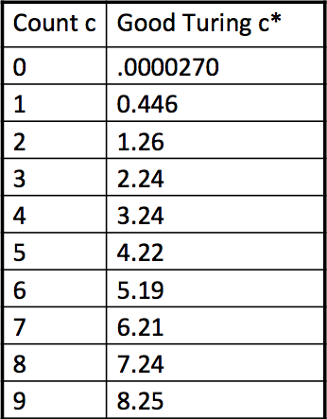
Good-Turing numbers: Example
22 million words of AP Neswire
_{c∗ =} (c + 1)N_{c+1}
N_{c}
It looks like c∗ = c − 0.75
ls
Week 3: Lecture 1
8 / 18

Slide 10
A simple Example
he is he is good man
Possible bigrams are:
(he,is) (is,he) (he,is) (is, good) ( good, man)
he,is | 2
is,he | 1
is,good | 1
goog,man | 1
Total no all possible bigrams:16
Bigrams actually found in training set:4
 | he | is | good | man
he | 0 | 2 | 0 | 0
is | 1 | 0 | 1 | 0
good | 0 | 0 | 0 | 1
man | 0 | 0 | 0 | 0

Slide 11



A simple Example
Bigram probabilities
$$N_{1}=3,N_{2}=1$$
 | he | is | good | man
he | 0 | 2/5 | 0 | 0
is | 1/5 | 0 | 1/5 | 0
good | 0 | 0 | 0 | 1/5
man | 0 | 0 | 0 | 0
$C^{∗}\left(he,he\right)=\frac{(0+1)N_{(0+1)}}{N_{0}}$=1
$$P_{GT}\left(he,he\right)=\frac{C^{∗}(he,he)}{N}=\frac{1}{5}$$

Slide 12
Kneser-Ney Smoothing
Intuition
Shannon game: I can’t see without my reading ...: glasses/Francisco?
“Francisco” more common that “glasses”
But “Francisco” mostly follows “San”
P(w): “How likely is w?”
Instead, P_{continuation}(w): “How likely is w to appear as a novel continuation?” For each word, count the number of bigram types it completes
Every bigram type was a novel continuation the first time it was seen
P_{continuation}(w) ∝ |{w_{i−1} : c(w_{i−1}, w) > 0}|
ls
Week 3: Lecture 1
10 / 18

Slide 13
Kneser-Ney Smoothing
How many times does w appear as a novel continuation?
P_{continuation}(w) ∝ |{w_{i−1} : c(w_{i−1}, w) > 0}|
Normalized by the total number of word bigram types
|{(w_{j−1}, w_{j}) : c(w_{j−1}, w_{j}) > 0}|
_{Pcontinuation(w) =} |{w_{i−1} : c(w_{i−1}, w) > 0}|
|{(w_{j−1}, w_{j}) : c(w_{j−1}, w_{j}) > 0}|
A frequent word (Francisco) occurring in only one context (San) will have a low continuation probability
ls
Week 3: Lecture 1
11 / 18

Slide 14
Kneser-Ney Smoothing
max(c(w
, w ) − d, 0)
PKN (wi|wi−1
) =
i−1 i
+ λ(w )P (w )
c(w_{i−1})
i−1 continuation i
λ is a normalizing constant
d
λ(w_{i−1}) = |{w : c(w_{i−1}, w) > 0}|
c(w_{i−1})
ls
Week 3: Lecture 1
12 / 18

Slide 15
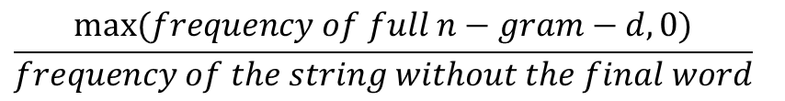

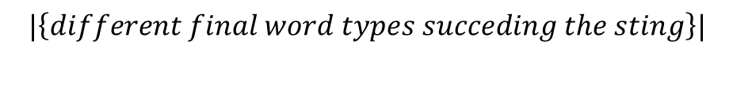
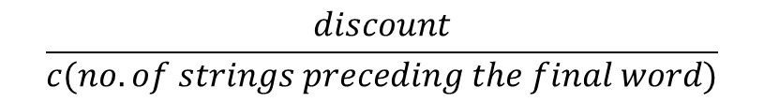

Kneser-Ney Smoothing
The first term meaning:
$$\frac{max⁡(c\left(w_{i−1},w_{i}\right)−d,0)}{c(w_{i−1})}$$
First term
$$\frac{max⁡(frequency of full n−gram−d,0)}{frequency of the string without the final word}$$
$$λ\left(w_{i−1}\right)=\frac{d}{c(w_{i−1})}|\left\{w:c\left(w_{i−1},w_{i}\right)\right\}|$$
Lambda term
$$\frac{discount}{c(no. of strings preceding the final word)}$$
$$|\left\{different final word types succeding the sting\right\}|$$

Slide 16
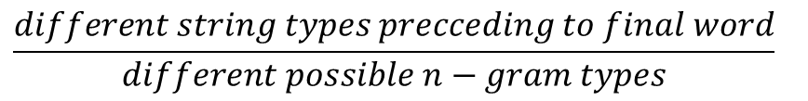
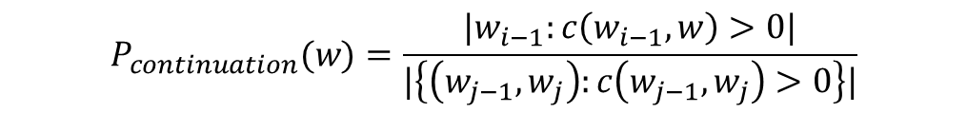
Kneser-Ney Smoothing
$$P_{continuation}(w)=\frac{|w_{i−1}:c\left(w_{i−1},w\right)>0|}{|\left\{\left(w_{j−1},w_{j}\right):c\left(w_{j−1},w_{j}\right)>0\right\}|}$$
Last terms
$$\frac{different string types precceding to final word}{different possible n−gram types}$$

Slide 17
Kneser-Ney Smoothing Example
Data set:
he can he can cook it but he is a writer
he,can | 2
can,he | 1
can,cook | 1
cook,it | 1
it,but | 1
but,he | 1
he,is | 1
is,a | 1
a,writer | 1
he | 3
can | 2
cook | 1
it | 1
but | 1
is | 1
a | 1
writer | 1

Slide 18
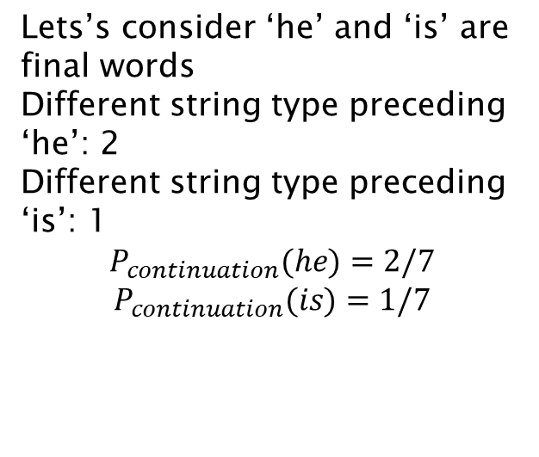
Kneser-Ney Smoothing Example
he,can,he | 1
can,he,can | 1
coot,it,but | 1
it,but,he | 1
but,he,is | 1
he,is,a | 1
is,a,writer | 1
Lets’s consider ‘he’ and ‘is’ are final words
Different string type preceding ‘he’: 2
Different string type preceding ‘is’: 1
$$P_{continuation}(he)=2/7$$
$$P_{continuation}(is)=1/7$$

Slide 19
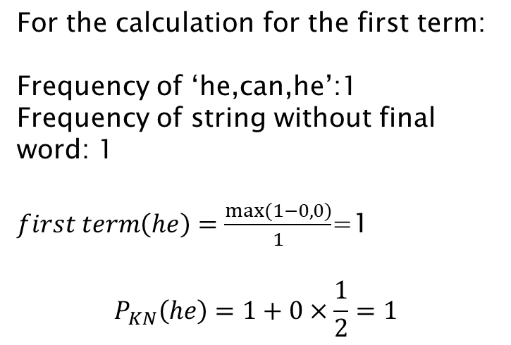
Kneser-Ney Smoothing Example
For the calculation for the first term:
Frequency of ‘he,can,he’:1
Frequency of string without final word: 1
$first term\left(he\right)=\frac{max⁡(1−0,0)}{1}$=1
$$P_{KN}\left(he\right)=1+0×\frac{1}{2}=1$$

Slide 20
Model Combination
As N increases
The power (expressiveness) of an N-gram model increases
But the ability to estimate accurate parameters from sparse data decreases (i.e. the smoothing problem gets worse).
A general approach is to combine the results of multiple N-gram models.
ls
Week 3: Lecture 1
13 / 18

Slide 21
Backoff and Interpolation
It might help to use less context
when you haven’t learned much about larger contexts
Backoff
use trigram if you have good evidence otherwise bigram, otherwise unigram
Interpolation
mix unigram, bigram, trigram
ls
Week 3: Lecture 1
14 / 18

Slide 22
Backoff
Estimating P(w_{i}|w_{i−2}w_{i−1})
If we do not have counts to compute P(w_{i}|w_{i−2}w_{i−1}) estimate this using the bigram probbaility P(w_{i}|w_{i−1})
If we do not have counts to compute P(w_{i}|w_{i−1}), estimate this using the unigram probability P(w_{i})
Pbo(wi|wi−2wi−1)=
P^{ˆ}(w_{i}|w_{i−2}w_{i−1}), if c(w_{i−2}w_{i−1}w_{i}) > 0
λ(w_{i−1}w_{i−2})P_{bo}(w_{i}|w_{i−1}), otherwise
where P_{bo}(w_{i}|w_{i−1}) = P^{ˆ}(w_{i}|w_{i−1}) if c(w_{i−1}w_{i}) > 0 λ(w_{n−1})P^{ˆ}(w_{n}), otherwise
ls
Week 3: Lecture 1
15 / 18

Slide 23
Example Problem
In a corpus, suppose there are 4 words, a, b, c, and d. You are provided with the following counts.
n-gram | count | n-gram | count | n-gram | count
aba | 4 | ba | 5 | a | 8
abb | 0 | bb | 3 | b | 9
abc | 0 | bc | 0 | c | 8
abd | 0 | bd | 0 | d | 7
Use the recursive definition of backoff smoothing to obtain the probability distribution, P_{backoff} (w_{n}|w_{n−2}w_{n−1}), where w_{n−1} = b and w_{n−2} = a.
Also assume that P^{ˆ}(x) = P(x) − 1/8.
ls
Week 3: Lecture 1

Slide 24
Linear Interpolation
Simple Interpolation
P˜(w_{n}|w_{n−1}w_{n−2}) = λ₁P(w_{n}|w_{n−1}w_{n−2}) + λ₂P(w_{n}|w_{n−1}) + λ₃P(w_{n})
∑λ_{i} = 1
i
Lambdas conditional on context
P˜(w_{n}|w_{n−1}w_{n−2}) = λ₁(w_{n−2}, w_{n−1})P(w_{n}|w_{n−1}w_{n−2})
+λ₂(w_{n−2}, w_{n−1})P(w_{n}|w_{n−1}) + λ₃(w_{n−2}, w_{n−1})P(w_{n})
ls
Week 3: Lecture 1
17 / 18

Slide 25
Setting the lambda values
Use a held-out corpus
Choose λs to maximize the probability of held-out data: Find the N-gram probabilities on the training data
Search for λs that give the largest probability to held-out data
ls
Week 3: Lecture 1
18 / 18

Slide 26
Computational Morphology
Week 3: Lecture 2
1 / 19

Slide 27
Morphology
Morphology studies the internal structure of words, how words are built up from smaller meaningful units called morphemes
dogs
2 morphemes, ‘dog’ and ‘s’
‘s’ is a plural marker on nouns
unladylike
3 morphemes
un- ‘not’
lady ‘well-behaved woman’
-like ‘having the characteristic of’
Week 3: Lecture 2
2 / 19

Slide 28
Allomorphs
Morphology
Variants of the same morpheme, but cannot be replaced by one another
Example
opposite: un-happy, in-comprehensible, im-possible, ir-rational

Slide 29
Allomorphs
Morphology
Variants of the same morpheme, but cannot be replaced by one another
Example
opposite: un-happy, in-comprehensible, im-possible, ir-rational

Slide 30
Bound and Free Morphemes
Bound
Cannot appear as a word by itself.
-s (dog-s), -ly (quick-ly), -ed (walk-ed)
Free
Can appear as a word by itself; often can combine with other morphemes too.
house (house-s), walk (walk-ed), of, the, or
Week 3: Lecture 2
4 / 19

Slide 31
Stems and Affixes
Stems and Affixes
Stems (roots): The core meaning bearing units
Affixes: Bits and pieces adhering to stems to change their meanings and grammatical functions
Mostly, stems are free morphemes and affixes are bound morphemes
Week 3: Lecture 2
5 / 19

Slide 32
Types of affixes
Prefix: un-, anti-, etc (a-, ati-, pra- etc.)
un-happy, pre-existing
Suffix: -ity, -ation, etc (-taa, -ke, -ka etc.)
talk-ing, quick-ly
Infix: ‘n’ in ‘vindati’ (he knows), as contrasted with vid (to know).
Philippines: basa ‘read’ → b-um-asa ‘read’ English: abso-bloody-lutely (emphasis)
Circumfixes - precedes and follows the stem
Dutch: berg ‘mountain’, ge-berg-te ‘mountains’
Week 3: Lecture 2
6 / 19

Slide 33
Content and functional morphemes
Content morphemes
Carry some semantic content
car, -able, un-
Functional morphemes
Provide grammatical information
-s (plural), -s (3rd singular)
Week 3: Lecture 2
7 / 19

Slide 34
Inflectional and Derivational Morphology
Two different kind of relationship among words
Inflectional morphology
Grammatical: number, tense, case, gender
Creates new forms of the same word: bring, brought, brings, bringing
Derivational morphology
Creates new words by changing part-of-speech: logic, logical, illogical, illogicality, logician
Fairly systematic but some derivations missing: sincere - sincerity, scarce - scarcity, curious - curiosity, fierce - fiercity?
Week 3: Lecture 2
8 / 19

Slide 35
Morphological processes
Concatenation
Adding continuous affixes - the most common process:
hope+less, un+happy, anti+capital+ist+s
Often, there are phonological/graphemic changes on morpheme boundaries: book + s [s], shoe + s [z]
happy +er → happier
Week 3: Lecture 2
9 / 19

Slide 36
Morphological processes
Reduplication: part of the word or the entire word is doubled Nama: ‘go’ (look), ‘go-go’ (examine with attention) Tagalog: ‘basa’ (read), ‘ba-basa’(will read)
Sanskrit: ‘pac’ (cook), ‘papa¯ ca’ (perfect form, cooked)
Phrasal reduplication (Telugu): pillava¯ d. u nad. ustu¯ nad. ustu¯ pad. i po¯ ya¯ d. u
(The child fell down while walking)
Week 3: Lecture 2
10 / 19

Slide 37
Morphological processes
Suppletion
‘irregular’ relation between the words
go - went, good - better
Morpheme internal changes
The word changes internally
sing - sang - sung, man - men, goose - geese
Week 3: Lecture 2
11 / 19

Slide 38
Word Formation
Compounding
Words formed by combining two or more words Example in English:
Adj + Adj → Adj: bitter-sweet N + N → N: rain-bow
V + N → V: pick-pocket P + V → V: over-do
Particular to languages
room-temperature: Hindi translation?
Week 3: Lecture 2

Slide 39
Word Formation
Acronyms
laser: Light Amplification by Simulated Emission of Radiation
Blending
Parts of two different words are combined breakfast + lunch → brunch
smoke + fog → smog motor + hotel → motel
Clipping
Longer words are shortened
doctor, laboratory, advertisement, dormitory, examination, bicycle, refrigerator
Week 3: Lecture 2
13 / 19

Slide 40
Processing morphology
Lemmatization: word → lemma saw → {see, saw}
Morphological analysis : word → setOf(lemma +tag) saw → { <see, verb.past>, < saw, noun.sg>}
Tagging: word → tag, considers context
Peter saw her → { <see, verb.past>} Morpheme segmentation: de-nation-al-iz-ation Generation: see + verb.past → saw
Week 3: Lecture 2
14 / 19

Slide 41
What are the applications?
Text-to-speech synthesis:
lead: verb or noun?
read: present or past?
Search and information retrieval Machine translation, grammar correction
Week 3: Lecture 2
15 / 19

Slide 42
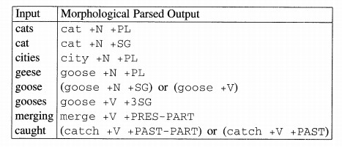
Morphological Analysis
Goal
To take input forms like those in the first column and produce output forms like those in the second column.
Output contains stem and additional information; +N for noun, +SG for singular, +PL for plural, +V for verb etc.
Week 3: Lecture 2
16 / 19

Slide 43
Issues involved
boy → boys
fly → flys → flies (y→ i rule)
Toiling → toil Duckling → duckl?
Getter → get + er Doer → do + er Beer → be + er?
Week 3: Lecture 2
17 / 19

Slide 44
Knowledge Required
Knowledge of stems or roots Duck is a possible root, not duckl. We need a dictionary (lexicon)
Morphotactics
Which class of morphemes follow other classes of morphemes inside the word?
Ex: plural morpheme follows the noun
Only some endings go on some words
Do+er: ok
Be+er: not so
Spelling change rules
Adjust the surface form using spelling change rules
Get + er → getter
Fox + s foxes
Week 3: Lecture 2
18 / 19

Slide 45
Why can’t this be put in a big lexicon?
English: just 317,477 forms from 90,196 lexical entries, a ratio of 3.5:1
Sanskrit: 11 million forms from a lexicon of 170,000 entries, a ratio of 64.7:1
New forms can be created, compounding etc.
One of the most common methods is finite-state-machines
Week 3: Lecture 2
19 / 19

Slide 46
Regular and Irregular Nouns
What are Regular Nouns?
Regular nouns are nouns that can be formed into their plural form by simply adding “-s” and “-es” to the end.
nouns that end with -ss, -s, -sh, -ch, -z, -x, and -o are converted into plural formation by adding “-es.”
What are Irregular Nouns?
do not follow the same rule of regular nouns or any standard rule when converting into plurals.
the irregular noun “child” changes into plural as “children.”

Slide 47
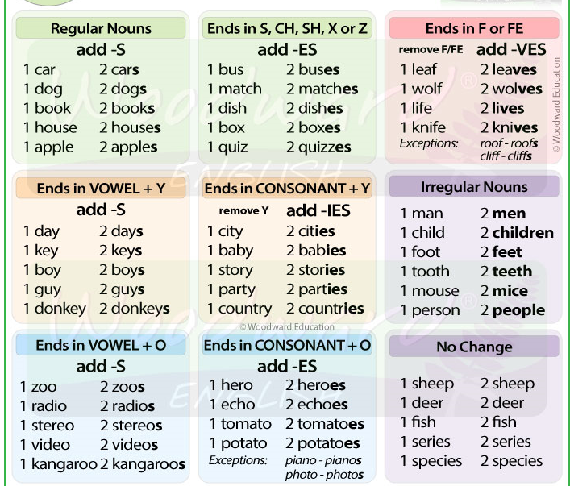
Regular and Irregular Nouns

Slide 48
Regular and Irregular Verbs
Regular verbs:
Talk-talked, love-loved, kill-killed
Irregular verbs:
Fly-flew-flown, fall-fell-fallen, choose-chose-chosen

Slide 49
Finite-state methods for morphology
Week 3: Lecture 3
1 / 18

Slide 50
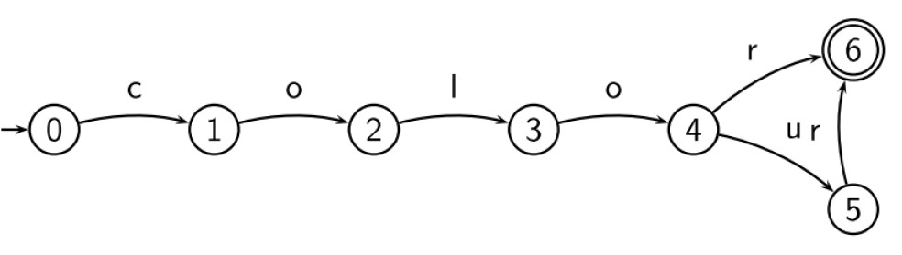
Finite State Automaton (FSA)
What is FSA?
A kind of directed graph
Nodes are called states, edges are labeled with symbols (possibly empty s)
Start state and accepting states
Recognizes regular languages, i.e., languages specified by regular expressions
Week 3: Lecture 3
2 / 18

Slide 51
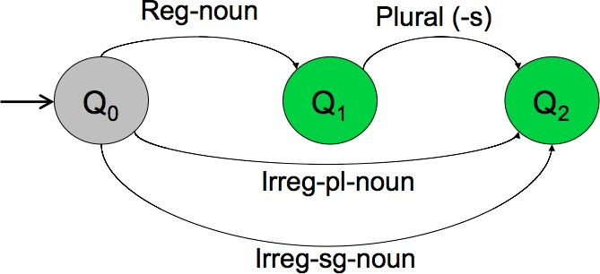
FSA for nominal inflection in English
3 / 18

Slide 52
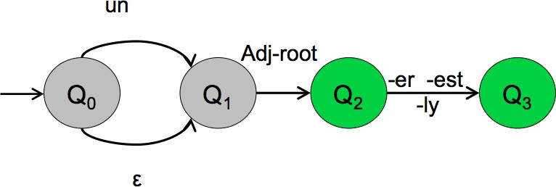
FSA for English Adjectives
Word modeled
happy, happier, happiest, real, unreal, cool, coolly, clear, clearly, unclear, unclearly, ...
Week 3: Lecture 3
4 / 18

Slide 53
Morphotactics
The last two examples model some parts of the English morphotactics But what about the information about regular and irregular roots?
Lexicon
Can we include the lexicon in the FSA?

Slide 54
FSA for nominal inflection in English
Week 3: Lecture 3
6 / 18

Slide 55
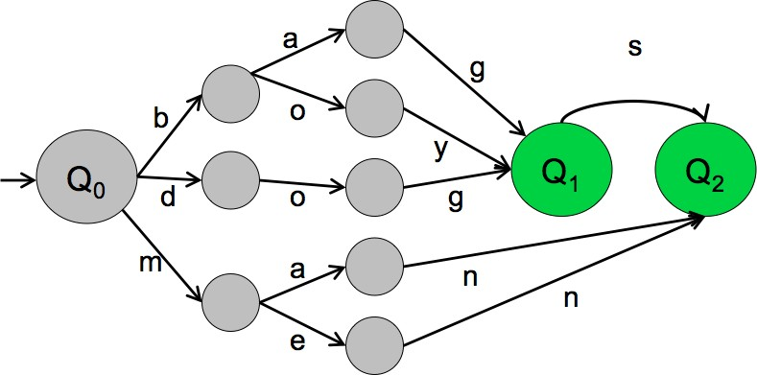
After adding a mini-lexicon
Week 3: Lecture 3
7 / 18

Slide 56
Some properties of FSAs: Elegance
Recognizing problem can be solved in linear time (independent of the size of the automaton)
There is an algorithm to transform each automaton into a unique equivalent automaton with the least number of states
An FSA is deterministic iff it has no empty (s) transition and for each state and each symbol, there is at most one applicable transition
Every non-deterministic automaton can be transformed into a deterministic one
Week 3: Lecture 3
8 / 18

Slide 57
But ...
FSAs are language recognizers/generators.
We need transducers to build Morphological Analyzers
Finite State Transducers
Translate strings from one language to strings in another language
Like FSA, but each edge is associated with two strings
Finite-state methods for morphology
Week 3: Lecture 3
9 / 18

Slide 58
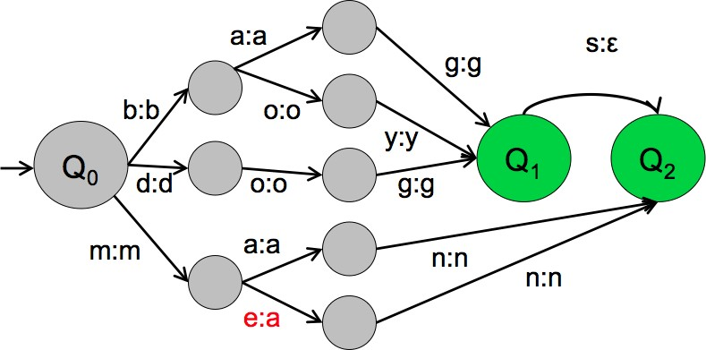
An example FST
Week 3: Lecture 3

Slide 59

Two-level morphology
Two-level morphology
Given the input cats, we would like to output cat+N+PL, talling us that cat is a plural noun.
We do this via a version of two-level morphology, a correspondence between a lexical level (morphemes and features) to a surface level (actual spelling).

Slide 60
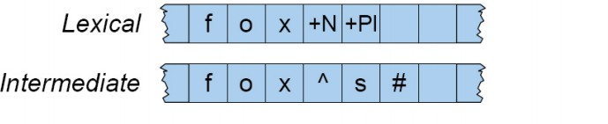
Intermediate tape for Spelling change rules
Week 3: Lecture 3

Slide 61
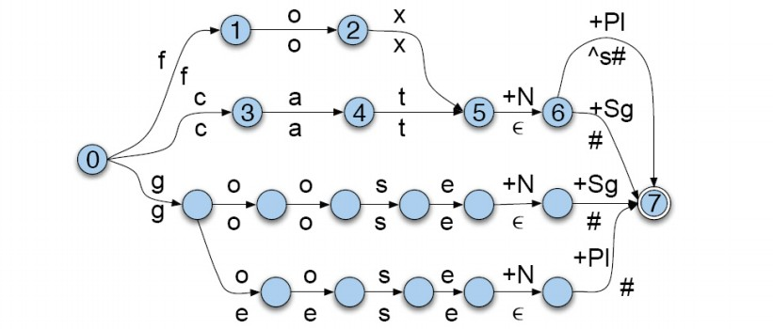
English Nominal Inflection FST
Week 3: Lecture 3

Slide 62
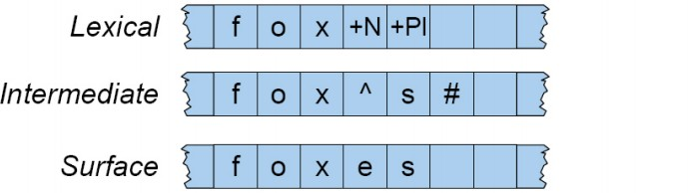
Spelling Handling
A spelling change rule would insert an e only in the appropriate environment.
Week 3: Lecture 3

Slide 63
Rule Handling
Rule Notation
a → b/c_d : “rewrite a as b when it occurs between c and d.”
Week 3: Lecture 3

Slide 64
Morphological Analysis: Approaches
Two different ways to address phonological/graphemic variations
Linguistic approach: A phonological component accompanying the simple concatenative process of attaching an ending
Engineering approach: Phonological changes and irregularities are factored into endings and a higher number of paradigms
Week 3: Lecture 3

Slide 65
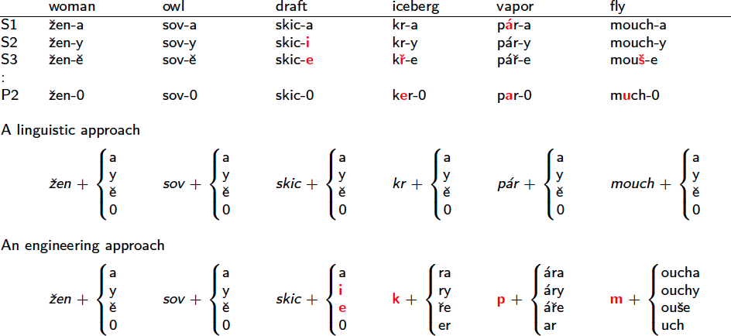
Different Approaches: Example from Czech
Week 3: Lecture 3

Slide 66
Introduction to POS Tagging
Week 3: Lecture 4
1 / 18

Slide 67
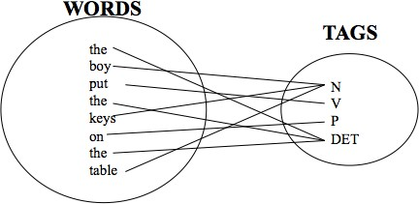
Part-of-Speech (POS) tagging
Part-of-Speech (POS) tagging
Task
Given a text of English, identify the parts of speech of each word

Slide 68
Parts of Speech: How many?
Open class words (content words)
nouns, verbs, adjectives, adverbs
mostly content-bearing: they refer to objects, actions, and features in the world
open class, since new words are added all the time
Closed class words
pronouns, determiners, prepositions, connectives, ...
there is a limited number of these
mostly functional: to tie the concepts of a sentence together
Week 3: Lecture 4
3 / 18

Slide 69
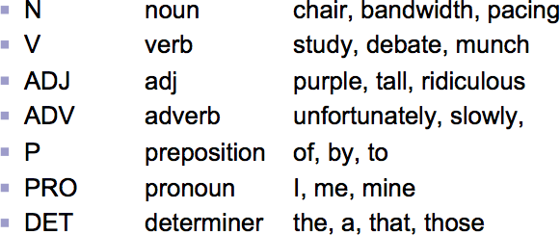
POS examples
Week 3: Lecture 4
4 / 18

Slide 70
POS tagging: Choosing a tagset
To do POS tagging, a standard set needs to be chosen Could pick very coarse tagsets
N, V, Adj, Adv
More commonly used set is finer grained, “UPenn TreeBank tagset”, 45 tags
A Nice Tutorial on POS tags
https://sites.google.com/site/partofspeechhelp/
Week 3: Lecture 4
5 / 18

Slide 71
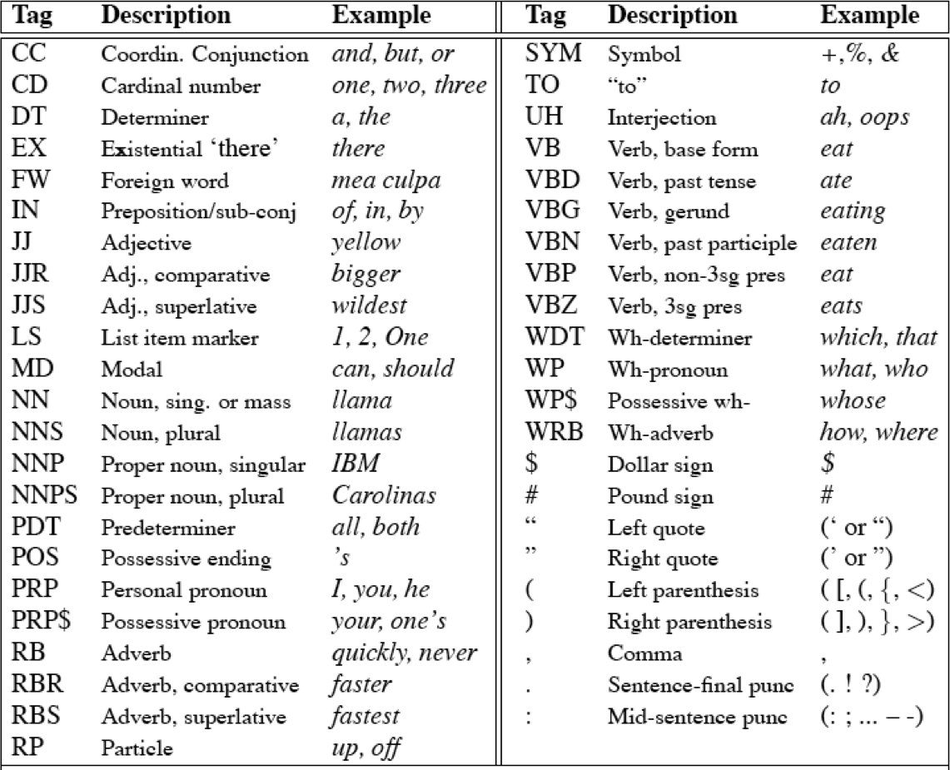
UPenn TreeBank POS tag set
Week 3: Lecture 4
6 / 18

Slide 72
Using the UPenn tagset
Example Sentence
The grand jury commented on a number of other topics.
POS tagged sentence
The/DT grand/JJ jury/NN commmented/VBD on/IN a/DT number/NN of/IN other/JJ topics/NNS ./.
Week 3: Lecture 4
7 / 18

Slide 73
Why is POS tagging hard?
Words often have more than one POS: back
The back door: back/JJ
On my back: back/NN
Win the voters back: back/RB
Promised to back the bill: back/VB
POS tagging problem
To determine the POS tag for a particular instance of a word
Week 3: Lecture 4
8 / 18

Slide 74
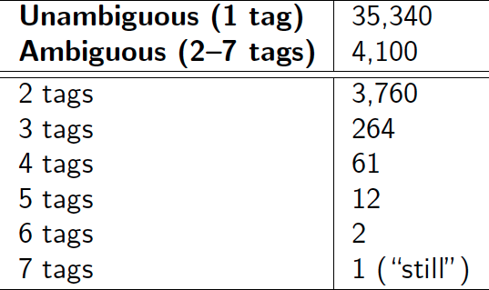
Ambiguous word types in the Brown Corpus
Ambiguity in the Brown corpus
40% of word tokens are ambiguous 12% of word types are ambiguous Breakdown of ambiguous word types:
Week 3: Lecture 4
9 / 18

Slide 75
How bad is the ambiguity problem?
One tag is usually more likely than the others.
In the Brown corpus, race is a noun 98% of the time, and a verb 2% of the time
A tagger for English that simply chooses the most likely tag for each word can achieve good performance
Any new approach should be compared against the unigram baseline (assigning each token to its most likely tag)
Week 3: Lecture 4
10 / 18

Slide 76
Deciding the correct POS
Can be difficult even for people
Mrs./NNP Shaefer/NNP never/RB got/VBD around/_ to/TO joining/VBG.
All/DT we/PRP gotta/VBN do/VB is/VBZ go/VB around/_ the/DT corner/NN.
Chateau/NNP Petrus/NNP costs/VBZ around/_ 2500/CD.
Week 3: Lecture 4

Slide 77
Deciding the correct POS
Can be difficult even for people
Mrs./NNP Shaefer/NNP never/RB got/VBD around/RP to/TO joining/VBG.
All/DT we/PRP gotta/VBN do/VB is/VBZ go/VB around/IN the/DT corner/NN.
Chateau/NNP Petrus/NNP costs/VBZ around/RB 2500/CD.

Slide 78
Deciding the correct POS
Can be difficult even for people
Mrs./NNP Shaefer/NNP never/RB got/VBD around/RP to/TO joining/VBG.
All/DT we/PRP gotta/VBN do/VB is/VBZ go/VB around/IN the/DT corner/NN.
Chateau/NNP Petrus/NNP costs/VBZ around/RB 2500/CD.
Week 3: Lecture 4

Slide 79
Relevant knowledge for POS tagging
The word itself
Some words may only be nouns, e.g. arrow
Some words are ambiguous, e.g. like, flies
Probabilities may help, if one tag is more likely than another
Week 3: Lecture 4
13 / 18

Slide 80
Relevant knowledge for POS tagging
The word itself
Some words may only be nouns, e.g. arrow
Some words are ambiguous, e.g. like, flies
Probabilities may help, if one tag is more likely than another
Local context
Two determiners rarely follow each other
Two base form verbs rarely follow each other
Determiner is almost always followed by adjective or noun
Week 3: Lecture 4
13 / 18

Slide 81
POS tagging: Two approaches
Rule-based Approach
Assign each word in the input a list of potential POS tags
Then winnow down this list to a single tag using hand-written rules
Statistical tagging
Get a training corpus of tagged text, learn the transformation rules from the most frequent tags (TBL tagger)
Probabilistic: Find the most likely sequence of tags T for a sequence of words W
Week 3: Lecture 4
14 / 18

Slide 82
TBL Tagger
Label the training set with most frequent tags
The can was rusted.
The/DT can/MD was/VBD rusted/VBD.
Add transformation rules to reduce training mistakes
MD →NN: DT_ VBD→VBN: VBD_
Week 3: Lecture 4
15 / 18

Slide 83
Probabilistic Tagging: Two different families of models
Problem at hand
We have some data {(d, c)} of paired observations d and hidden classes c.
Different instances of d and c
Part-of-Speech Tagging:
Week 3: Lecture 4
16 / 18

Slide 84
Probabilistic Tagging: Two different families of models
Problem at hand
We have some data {(d, c)} of paired observations d and hidden classes c.
Different instances of d and c
Part-of-Speech Tagging: words are observed and tags are hidden.
Text Classification:
Week 3: Lecture 4
16 / 18

Slide 85
Probabilistic Tagging: Two different families of models
Problem at hand
We have some data {(d, c)} of paired observations d and hidden classes c.
Different instances of d and c
Part-of-Speech Tagging: words are observed and tags are hidden.
Text Classification: sentences/documents are observed and the category is hidden.
Week 3: Lecture 4
16 / 18

Slide 86
Probabilistic Tagging: Two different families of models
Problem at hand
We have some data {(d, c)} of paired observations d and hidden classes c.
Different instances of d and c
Part-of-Speech Tagging: words are observed and tags are hidden.
Text Classification: sentences/documents are observed and the category is hidden.
Categories can be positive/negative for sentiments .. sports/politics/business for documents ...
Week 3: Lecture 4
16 / 18

Slide 87
Probabilistic Tagging: Two different families of models
Problem at hand
We have some data {(d, c)} of paired observations d and hidden classes c.
Different instances of d and c
Part-of-Speech Tagging: words are observed and tags are hidden.
Text Classification: sentences/documents are observed and the category is hidden.
Categories can be positive/negative for sentiments .. sports/politics/business for documents ...
What gives rise to the two families?
Whether they generate the observed data from hidden stuff or the hidden structure given the data?
Week 3: Lecture 4
16 / 18

Slide 88
Hidden Markov Models for POS Tagging
Week 3: Lecture 5
1 / 17

Slide 89
Stochastic/Random Process
Stochastic:
Having a random probability distribution or pattern that may be analyzed statistically but may not be predicted.
Process:
A series of actions or steps taken in order to achieve a particular end

Slide 90
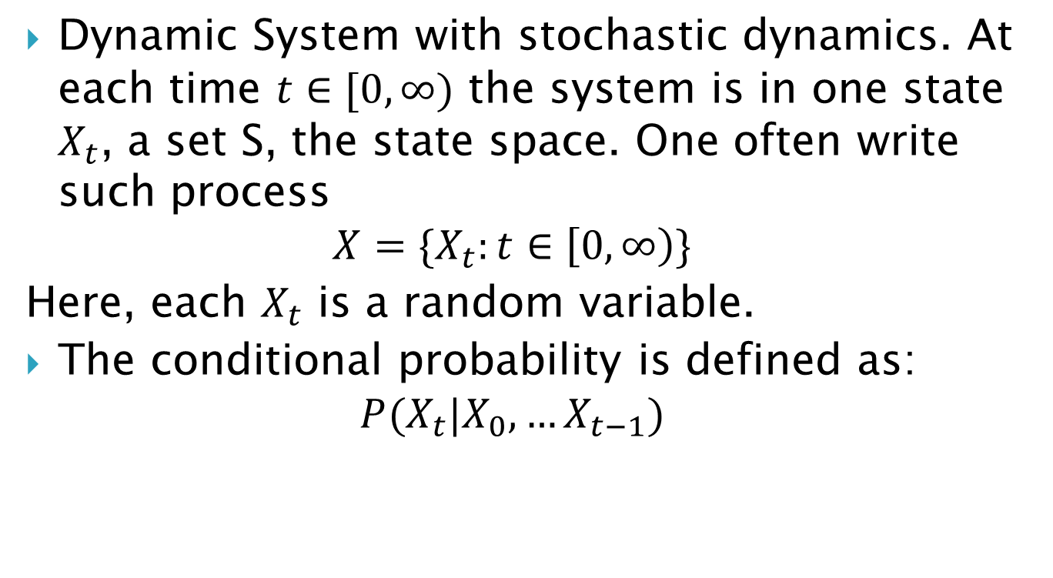
Stochastic/Random Process
Dynamic System with stochastic dynamics. At each time $t∈[0,∞)$ the system is in one state $X_{t}$, a set S, the state space. One often write such process
$$X=\{X_{t}:t∈\left[0,∞\right)\}$$
Here, each $X_{t}$ is a random variable.
The conditional probability is defined as:
$$P(X_{t}|X_{0},…X_{t−1})$$

Slide 91
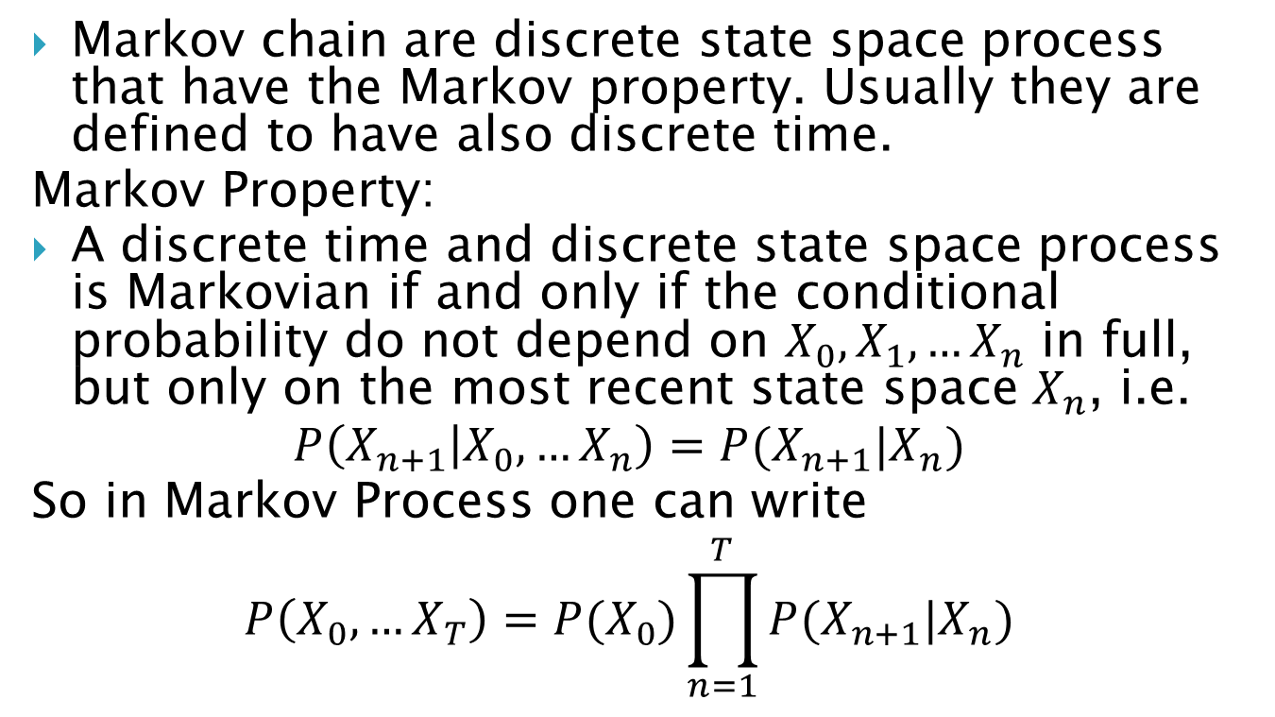
Markov Chain
Markov chain are discrete state space process that have the Markov property. Usually they are defined to have also discrete time.
Markov Property:
A discrete time and discrete state space process is Markovian if and only if the conditional probability do not depend on $X_{0},X_{1},…X_{n}$ in full, but only on the most recent state space $X_{n}$, i.e.
$$P\left(X_{n+1} | X_{0},…X_{n}\right)=P(X_{n+1}|X_{n})$$
So in Markov Process one can write
$$P\left(X_{0},…X_{T}\right)=P(X_{0})\prod_{n=1}^{T}{P{(X}_{n+1}|X_{n})}$$

Slide 92
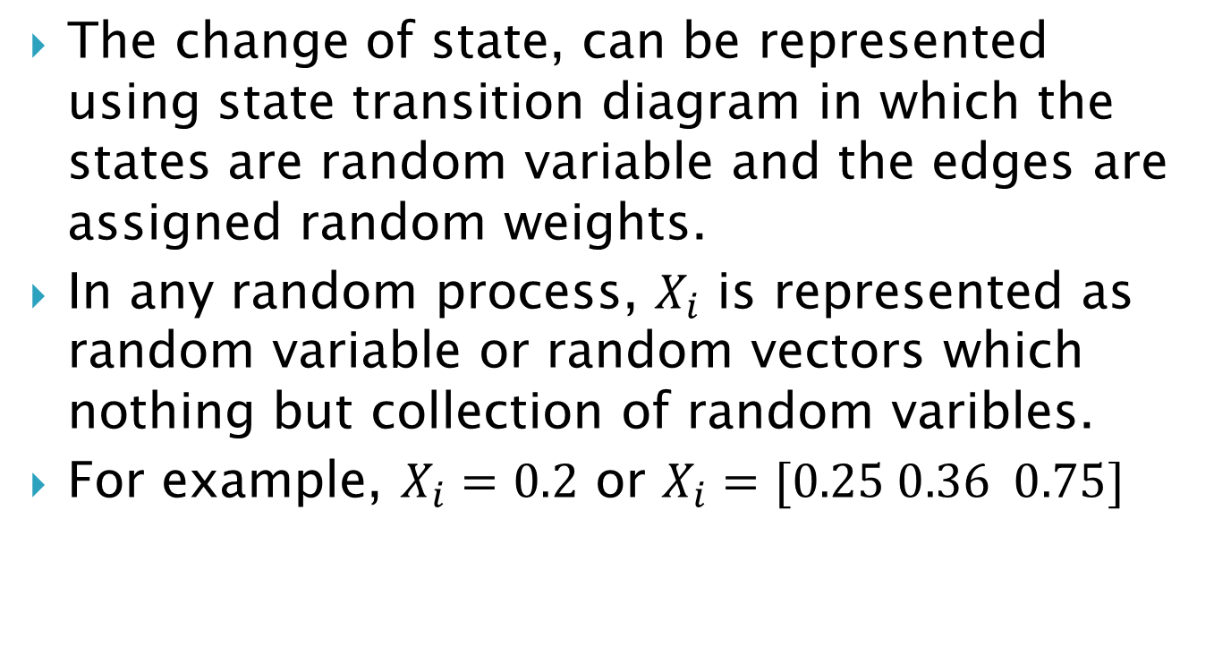
Markov Transition Matrix
The change of state, can be represented using state transition diagram in which the states are random variable and the edges are assigned random weights.
In any random process, $X_{i}$ is represented as random variable or random vectors which nothing but collection of random varibles.
For example, $X_{i}=0.2$ or $X_{i}=[0.25 0.36 0.75]$

Slide 93
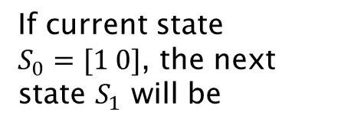
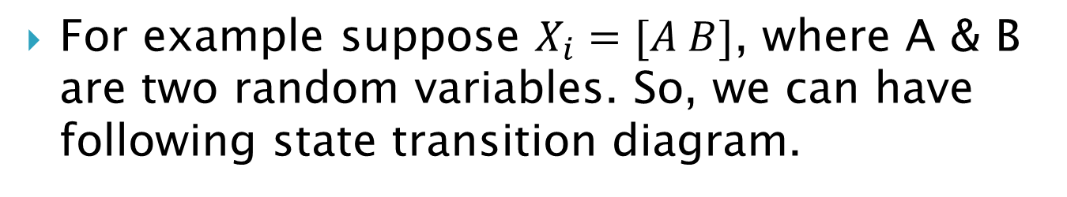
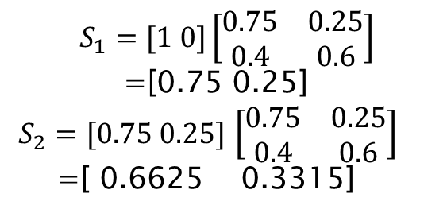
Markov Transition Matrix
For example suppose $X_{i}=[A B]$, where A & B are two random variables. So, we can have following state transition diagram.
 | A | B
A | 0.75 | 0.25
B | 0.4 | 0.6
0.25
A
B
0.6
0.75
0.4
$$S_{1}=[1 0]\left[\begin{matrix}0.75 & 0.25 \\ 0.4 & 0.6\end{matrix}\right]$$
=[0.75 0.25]
$S_{2}=[0.75 0.25]$ $\left[\begin{matrix}0.75 & 0.25 \\ 0.4 & 0.6\end{matrix}\right]$
=[ 0.6625 0.3315]
If current state $S_{0}=[1 0]$, the next state $S_{1}$ will be

Slide 94
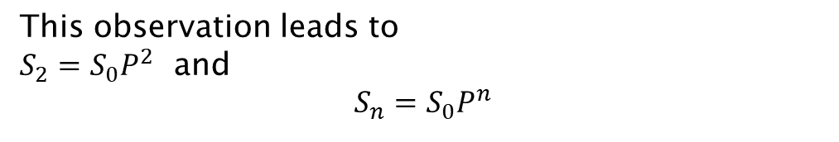

Markov Transition Matrix
For example suppose $X_{i}=[A B]$, where A & B are two random variables. So, we can have following state transition diagram.
 | A | B
A | 0.75 | 0.25
B | 0.4 | 0.6
0.25
P=
A
B
0.6
0.75
0.4
If current state $S_{0}=[1 0]$, the next state $S_{1}$ will be
$$S_{2}=[1 0]\left[\begin{matrix}0.75 & 0.25 \\ 0.4 & 0.6\end{matrix}\right]\left[\begin{matrix}0.75 & 0.25 \\ 0.4 & 0.6\end{matrix}\right]$$
This observation leads to
$S_{2}=S_{0}P^{2}$ and
$$S_{n}=S_{0}P^{n}$$

Slide 95
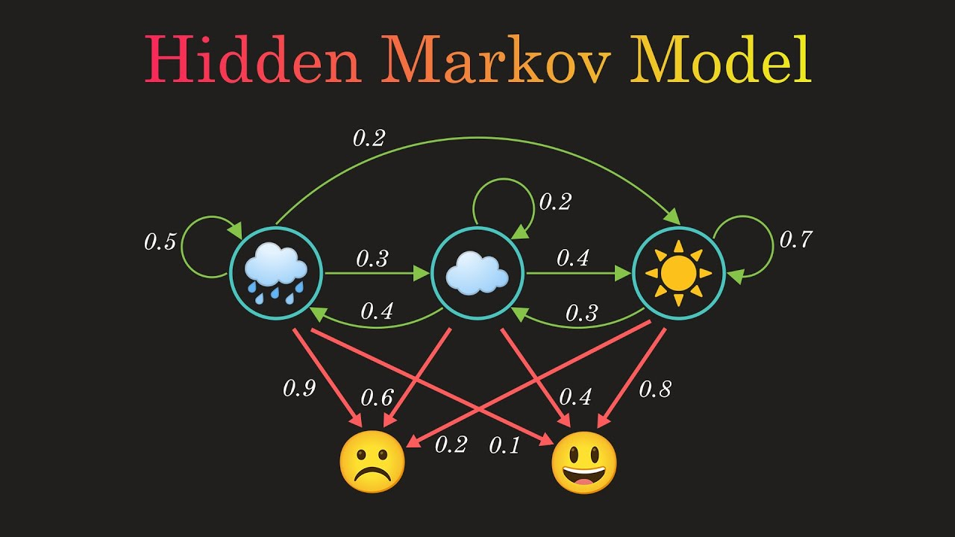
Hidden Markov Model(HMM)
Hidden States
Observed Variables
HMM=Markov Chain+ Observed variables

Slide 96
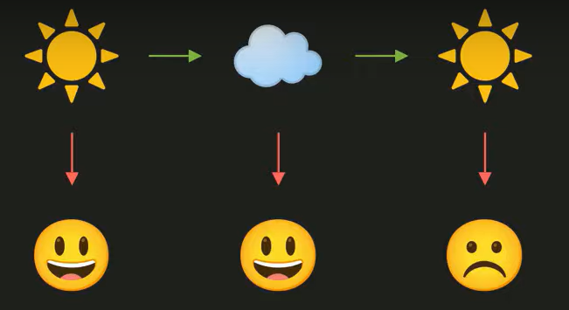
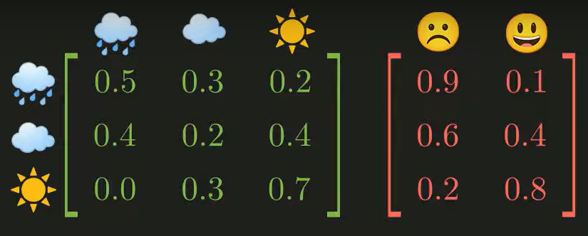
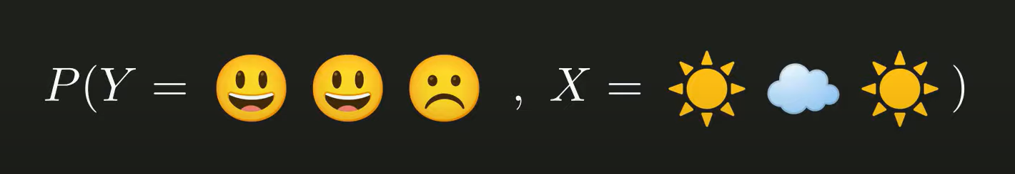
Hidden Markov Model(HMM)

Slide 97
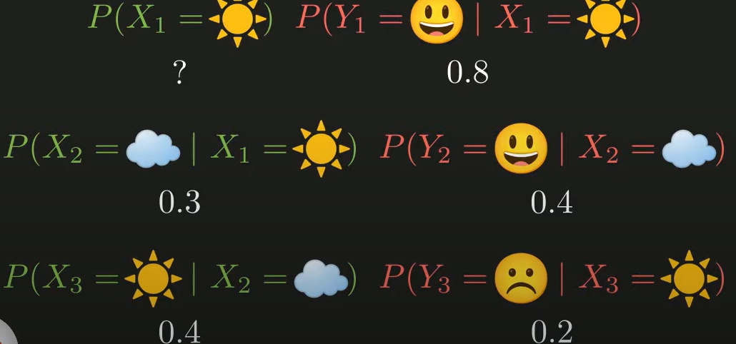

Slide 98
What is the probability of weather for following sequence of mood
0.04105

Slide 99
Probabilistic Tagging
W = w₁ . . . w_{n} - words in the corpus (observed)
T = t₁ . . . t_{n} - the corresponding tags (unknown)
Tagging: Probabilistic View (Generative Model)
Find
_{T}ˆ
= argmax_{T}P(T|W)
_{argmaxT} P(W|T)P(T)
=
P(W)
= argmax_{T}P(W|T)P(T)
.
= argmax P
(w |w . . . w , t . . . t )P(t |
t . . . t )
T
i 1 i−1 1 i i 1 i−1
i
Week 3: Lecture 5
2 / 17

Slide 100
Further simplifications
.
ˆ
T = argmax P
(w |w . . . w , t . . . t )P(t |t . . . t )
T i 1 i−1 1 i i 1 i−1
i
The probability of a word appearing depends only on its own POS tag
P(w_{i}|w₁ . . . w_{i−1}, t₁ . . . t_{i}) ≈ P(w_{i}|t_{i})
Bigram assumption: the probability of a tag appearing depends only on the previous tag
P(t_{i}|t₁ . . . t_{i−1}) ≈ P(t_{i}|t_{i−1})
Using these simplifications:
.
ˆ
T = argmax P
(w |t )P(t |t )
T
i i i i−1
i
Week 3: Lecture 5
3 / 17

Slide 101
Computing the probability values
Tag Transition probabilities p(t_{i}|t_{i−1})
C(t_{i−1}, t_{i}) C(t_{i−1})
P(t_{i}|t_{i−1}) =
C(DT, NN) 56
, 509
P(NN|
DT) =
=
= 0.49
C(DT) 116, 454
Word Likelihood probabilities p(w_{i}|t_{i})
C(t_{i}, w_{i})
P(w |t ) =
i i
C(t_{i})
C(VBZ, is) 10
, 073
P(is|VBZ) =
=
= 0.47
C(VBZ) 21, 627
Week 3: Lecture 5
4 / 17

Slide 102
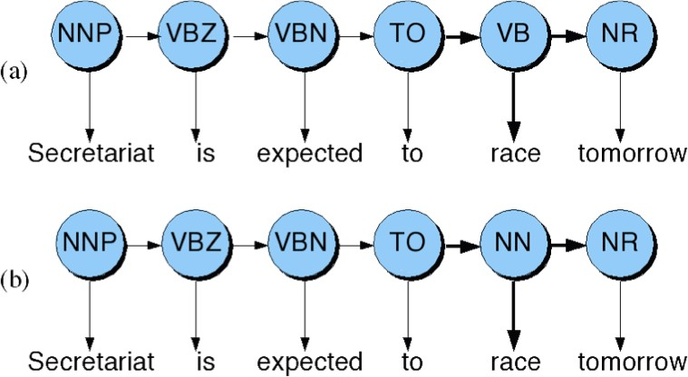
Disambiguating “race”
Week 3: Lecture 5
5 / 17

Slide 103
Disambiguating “race”
Difference in probability due to P(VB|TO) vs. P(NN|TO)
P(race|VB) vs. P(race|NN) P(NR|VB) vs. P(NR|NN)
After computing the probabilities
P(NN|TO)P(NR|NN)P(race|NN) = 0.0047 × 0.0012 × 0.00057 =
0.00000000032
P(VB|TO)P(NR|VB)P(race|VB) = 0.83 × 0.0027 × 0.00012 = 0.00000027
Week 3: Lecture 5
6 / 17

Slide 104
What is this model?
This is a Hidden Markov Model
Week 3: Lecture 5
7 / 17

Slide 105
Hidden Markov Models
Tag Transition probabilities p(t_{i}|t_{i−1})
Word Likelihood probabilities (emissions) p(w_{i}|t_{i})
What we have described with these probabilities is a hidden markov model.
Let us quickly introduce the Markov Chain, or observable Markov Model.
Week 3: Lecture 5
8 / 17

Slide 106
Markov Chain = First-order Markov Model
Weather example
Three types of weather: sunny, rainy, foggy
q_{n}: variable denoting the weather on the n^{th} day
We want to find the following conditional probabilities:
P(q_{n}|q_{n−1}, q_{n−2},..., q₁)
First-order Markov Assumption
P(q_{n}|q_{n−1}, q_{n−2},..., q₁) = P(q_{n}|q_{n−1})
Week 3: Lecture 5
9 / 17

Slide 107
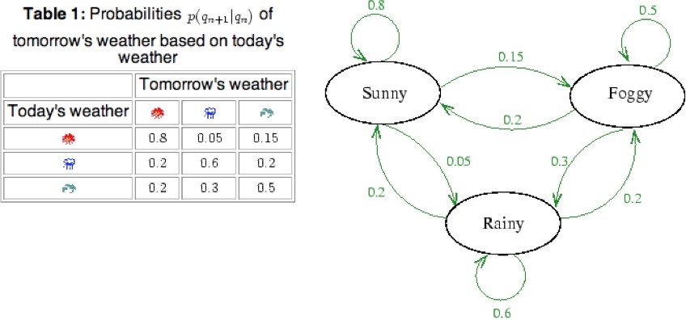
Markov Chain Transition Table
Week 3: Lecture 5

Slide 108
Using Markov Chain
Given that today the weather is sunny, what is the probability that tomorrow is sunny and day after is rainy?
P(q₂ = sunny, q₃ = rainy|q₁ = sunny)
= P(q₃ = rainy|q₂ = sunny, q₁ = sunny) × P(q₂ = sunny|q₁ = sunny)
= P(q₃ = rainy|q₂ = sunny) × P(q₂ = sunny|q₁ = sunny)
= 0.05 × 0.8
= 0.04
Week 3: Lecture 5
11 / 17

Slide 109
Hidden Markov Model
For Markov chains, the output symbols are the same as the states
‘sunny’ weather is both observable and state

Slide 110
Hidden Markov Model
For Markov chains, the output symbols are the same as the states
‘sunny’ weather is both observable and state
But in POS tagging

Slide 111
Hidden Markov Model
For Markov chains, the output symbols are the same as the states
‘sunny’ weather is both observable and state
But in POS tagging
The output symbols are words
Week 3: Lecture 5
12 / 17

Slide 112
Hidden Markov Model
For Markov chains, the output symbols are the same as the states
‘sunny’ weather is both observable and state
But in POS tagging
The output symbols are words
But the hidden states are POS tags
A Hidden Markov Model is an extension of a Markov chain in which the output symbols are not the same as the states
We don’t know which state we are in
Week 3: Lecture 5
12 / 17

Slide 113
Hidden Markov Models (HMMs)
Elements of an HMM model
A set of states (here: the tags) An output alphabet (here: words)
Initial state (here: beginning of sentence) State transition probabilities (here p(t_{n}|t_{n−1})) Symbol emission probabilities (here p(w_{i}|t_{i}))
Week 3: Lecture 5

Slide 114
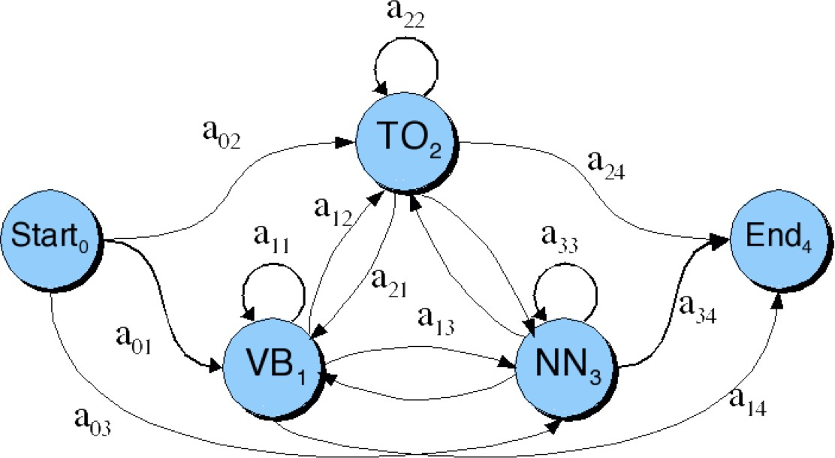
Graphical Representation
When tagging a sentence, we are walking through the state graph:
Edges are labeled with the state transition probabilities: p(t_{n}|t_{n−1})

Slide 115
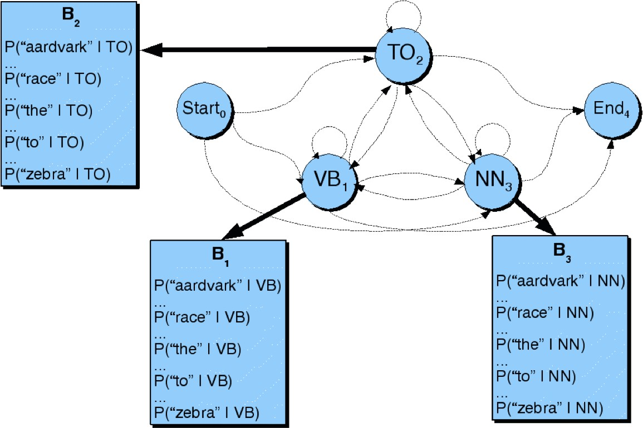
Graphical Representation
At each state we emit a word: P(w_{n}|t_{n})
Week 3: Lecture 5

Slide 116
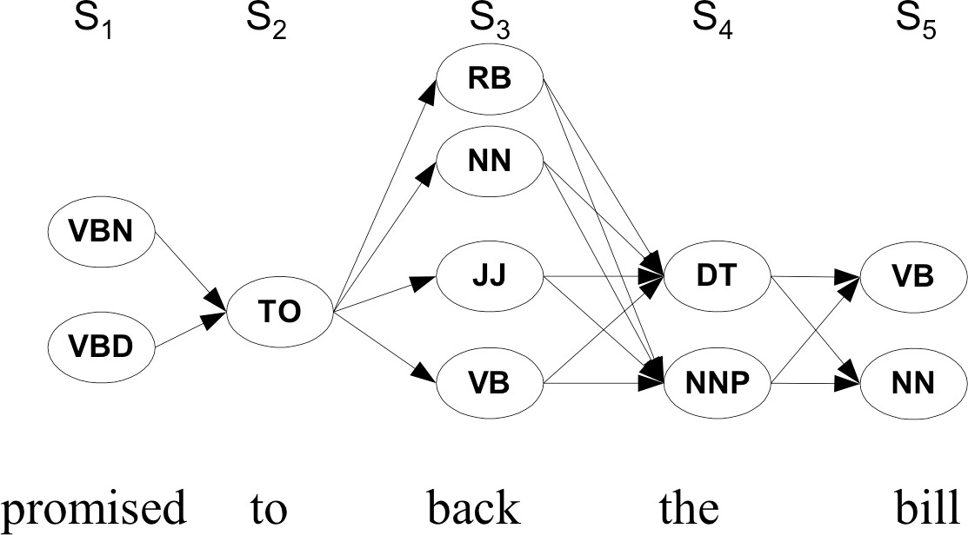
Walking through the states: best path
Week 3: Lecture 5

Slide 117
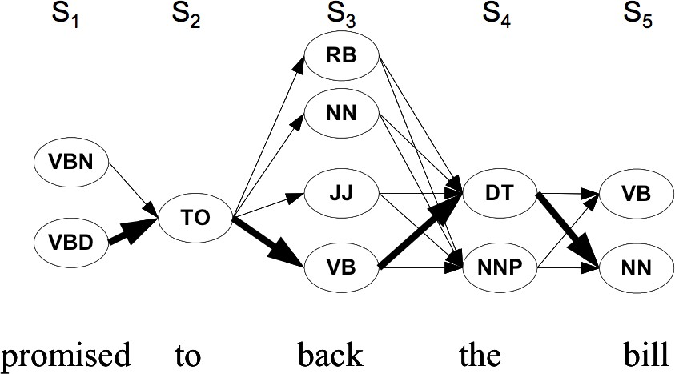
Walking through the states: best path
Week 3: Lecture 5

Slide 118
Viterbi Decoding for HMM, Parameter Learning
Week 4, Lecture 1

Slide 119
Walking through the states: best path
Week 4, Lecture 1

Slide 120
Walking through the states: best path
Week 4, Lecture 1

Slide 121
Finding the best path: Viterbi Algorithm
Intuition
Optimal path for each state can be recorded. We need
Cheapest cost to state j at step s: δ_{j}(s)
Backtrace from that state to best predecessor ψ_{j}(s)
Week 4, Lecture 1
4 / 6

Slide 122
Finding the best path: Viterbi Algorithm
Intuition
Optimal path for each state can be recorded. We need
Cheapest cost to state j at step s: δ_{j}(s)
Backtrace from that state to best predecessor ψ_{j}(s)
Computing these values
δ_{j}(s + 1) = max_{1≤i≤N} δ_{i}(s)p(t_{j}|t_{i})p(w_{s+1}|t_{j})
Week 4, Lecture 1
4 / 6

Slide 123
Finding the best path: Viterbi Algorithm
Intuition
Optimal path for each state can be recorded. We need
Cheapest cost to state j at step s: δ_{j}(s)
Backtrace from that state to best predecessor ψ_{j}(s)
Computing these values
δ_{j}(s + 1) = max_{1≤i≤N} δ_{i}(s)p(t_{j}|t_{i})p(w_{s+1}|t_{j}) ψ_{j}(s + 1) = argmax_{1≤i≤N} δ_{i}(s)p(t_{j}|t_{i})p(w_{s+1}|t_{j})
Week 4, Lecture 1
4 / 6

Slide 124
Finding the best path: Viterbi Algorithm
Intuition
Optimal path for each state can be recorded. We need
Cheapest cost to state j at step s: δ_{j}(s)
Backtrace from that state to best predecessor ψ_{j}(s)
Computing these values
δ_{j}(s + 1) = max_{1≤i≤N} δ_{i}(s)p(t_{j}|t_{i})p(w_{s+1}|t_{j}) ψ_{j}(s + 1) = argmax_{1≤i≤N} δ_{i}(s)p(t_{j}|t_{i})p(w_{s+1}|t_{j})
Best final state is argmax_{1≤i≤N} δ_{i}(|S|), we can backtrack from there
Week 4, Lecture 1
4 / 6

Slide 125
Practice Question
Suppose you want to use a HMM tagger to tag the phrase, “the light book”, where we have the following probabilities:
P(the|Det) = 0.3, P(the|Noun) = 0.1, P(light|Noun) = 0.003, P(light|Adj) = 0.002, P(light|Verb) = 0.06, P(book|Noun) = 0.003, P(book|Verb) = 0.01
P(Verb|Det) = 0.00001, P(Noun|Det) = 0.5, P(Adj|Det) = 0.3,
P(Noun|Noun) =0.2, P(Adj|Noun) = 0.002, P(Noun|Adj) = 0.2,
P(Noun|Verb) = 0.3, P(Verb|Noun) = 0.3, P(Verb|Adj) = 0.001,
P(Verb|Verb) = 0.1
Work out in details the steps of the Viterbi algorithm. You can use a Table to show the steps. Assume all other conditional probabilities, not mentioned to be zero. Also, assume that all tags have the same probabilities to appear in the beginning of a sentence.
Week 4, Lecture 1

Slide 126
Learning the Parameters
Two Scenarios
A labeled dataset is available, with the POS category of individual words in a corpus
Only the corpus is available, but not labeled with the POS categories
Methods for these scenarios
For the first scenario, parameters can be directly estimated using maximum likelihood estimate from the labeled dataset
For the second scenario, Baum-Welch Algorithm is used to estimate the parameters of the hidden markov model.
Week 4, Lecture 1
6 / 6

Slide 127
Baum Welch Algorithm
Week 4, Lecture 2
1 / 6

Slide 128
Baum Welch Algorithm
Uses the well-known EM algorithm to find the maximum likelihood estimate of the parameters of a hidden markov model
Parameters of HMM
Let X_{t} be the random variable denoting hidden state at time t, and Y_{t} be the observation variable at time T. HMM parameters are given by θ = (A, B, π) where
A = {a_{ij}} = P(X_{t} = j|X_{t−1} = i) is the state transition matrix
π = {π_{i}} = P(X₁ = i) is the initial state distribution
B = {b_{j}(y_{t})} = P(Y_{t} = y_{t}|X_{t} = j) is the emission matrix
Given observation sequences Y = (Y₁ = y₁, Y₂ = y₂, . . . , Y_{T} = y_{T} ), the algorithm tries to find the parameters θ that maximise the probability of the observation.
Week 4, Lecture 2
2 / 6

Slide 129
The Algorithm
The basic idea is to start with some random initial conditions on the parameters θ, estimate best values of state paths X_{t} using these, then
re-estimate the parameters θ using the just-computed values of X_{t}, iteratively.
Intuition
Choose some initial values for θ = (A, B, π).
Repeat the following step until convergence:
Determine probable (state) paths . . . X_{t−1} = i, X_{t} = j . . .
Count the expected number of transitions a_{ij} as well as the expected number of times, various emissions b_{j}(y_{t}) are made
Re-estimate θ = (A, B, π) using a_{ij} and b_{j}(y_{t})s.
A forward-backward algorithm is used for finding probable paths.
Week 4, Lecture 2
3 / 6

Slide 130
Forward-Backward Algorithm
Forward Procedure
α_{i}(t) = P(Y₁ = y₁, . . . , Y_{t} = y_{t}, X_{t} = i|θ) be the probability of seeing y₁, . . . , y_{t}
and being in state i at time t. Found recursively using:
α_{i}(1) = π_{i}b_{i}(y₁)
N
α (t + 1) = b (y ) α (t)a
j j t+1 Σ i ij
i=1
Backward Procedure
β_{i}(t) = P(Y_{t+1} = y_{t+1},..., Y_{T} = y_{T} |X_{t} = i, θ) be the probability of ending partial sequence y_{t+1},..., y_{T} given starting state i at time t. β_{i}(t) is computed recursively as:
β_{i}(T) = 1
N
β (t) = Σ β
(t + 1)a b (y )
i
j
ij j t+1
j=1
Week 4, Lecture 2
4 / 6

Slide 131
Finding probabilities of paths
We compute the following variables:
Probability of being in state i at time t given the observation Y and parameters θ
α_{i}(t)β_{i}(t)
γ_{i}(t) = P(X_{t} = i|Y, θ) =
.
N
Σ
α_{j}(t)β_{j}(t)
j=1
Probability of being in state i and j at time t and t + 1 respectively given the observation Y and parameters θ
α_{i}(t)a_{ij}β_{j}(t + 1)b_{j}(y_{t+1})
ζ (t) = P
(X = i
, X = j|Y, θ) =
. .
ij
t
t+1
N N
α_{i}(t)a_{ij}β_{j}(t + 1)b_{j}(y_{t+1})
Σ Σ
i=1 j=1
Week 4, Lecture 2

Slide 132
Updating the parameters
π_{i} = γ_{i}(1), expected number of times state i was seen at time 1
.
T
Σ
ζ (t)
a =
.
ij
, expected number of transitions from state i to state j,
ij T
t=1
t=1
γi(t)
compared to the total number of transitions away from state i
.
T
1 γ (t)
b (v ) =
.
y =v i
with 1
t
being an indicator function, is the
i k
t=1 k
yt =vk
T
γi(t)
t=1
expected number of times the output observations are v_{k} while being in state i compared to the expected total number of times in state i.
Week 4, Lecture 2

Slide 133
Maximum Entropy Models
Week 4, Lecture 3
1 / 16

Slide 134
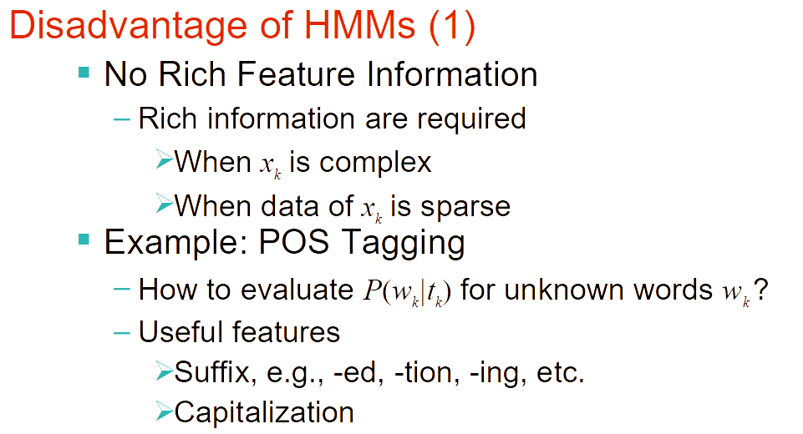

Slide 135
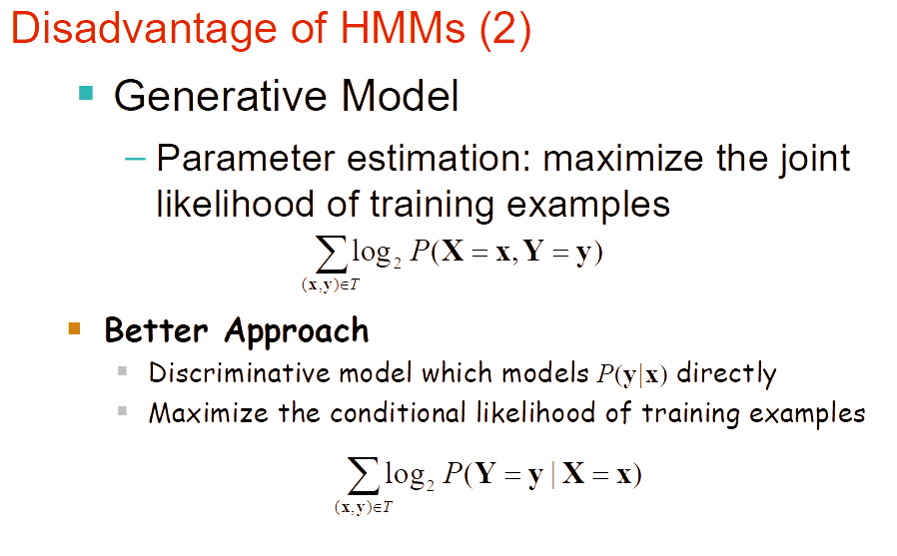

Slide 136
Issues with Markov Model Tagging
Unknown Words
We do not have the required probabilities.
Possible solutions:
Use morphological cues (capitalization, suffix) to assign a more calculated guess
Limited Context
“is clearly marked” → verb, past participle
“he clearly marked” → verb, past tense
Possible solution: Use higher order model, combine various n-gram models to avoid sparseness problem
Week 4, Lecture 3
2 / 16

Slide 137
Maximum Entropy Modeling: Discriminative Model
We may identify a heterogeneous set of features which contribute in some way to the choice of POS tag of the current word.
Whether it is the first word in the article
Whether the next word is to
Whether one of the last 5 words is a preposition, etc.
MaxEnt combines these features in a probabilistic model
Week 4, Lecture 3
3 / 16

Slide 138
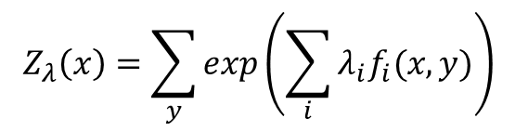
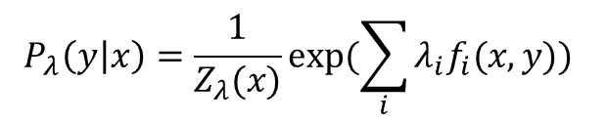
Maximum Entropy: The Model
$$P_{λ}\left(y | x\right)=\frac{1}{Z_{λ}(x)}exp⁡(\sum_{i}{λ_{i}f_{i}(x,y))}$$

where
Z_{λ}(x) is a normalizing constant given by
$$Z_{λ}\left(x\right)=\sum_{y}{exp\left(\sum_{i}{λ_{i}f_{i}(x,y)}\right)}$$
λ_{i} is a weight given to a feature f_{i}
x denotes an observed datum and y denotes a class
What is the form of the features?
Week 4, Lecture 3
4 / 16

Slide 139
Features in Maximum Entropy Models
Features encode elements of the context x for predicting tag y
Context x is taken around the word w, for which a tag y is to be predicted Features are binary values functions, e.g.,
⁽1 if isCapitalized(w)&y = NNP ⁾
0 otherwise
f (x, y) =
Week 4, Lecture 3
5 / 16

Slide 140
Example Features
Example: Named Entities LOCATION (in Arcadia) LOCATION (in Québec)
DRUG (taking Zantac) PERSON (saw Sue)
Week 4, Lecture 3
6 / 16

Slide 141
Example Features
Example: Named Entities LOCATION (in Arcadia) LOCATION (in Québec)
DRUG (taking Zantac) PERSON (saw Sue)
Example Features
f₁(x, y) = [y = LOCATION ∧ w₋₁ = “in” ∧ isCapitalized(w)] f₂(x, y) = [y = LOCATION ∧ hasAccentedLatinChar(w)] f₃(x, y) = [y = DRUG ∧ ends(w, “c”)]
Week 4, Lecture 3
6 / 16

Slide 142
Tagging with Maximum Entropy Model
W = w₁ . . . w_{n} - words in the corpus (observed)
T = t₁ . . . t_{n} - the corresponding tags (unknown)
Tag sequence candidate {t₁, . . . , t_{n}} has conditional probability:
n
.
P(t , . . . , t |w . . . , w ) = Σ p
(t |x )
1 n 1 n
i i
i=1
The context x_{i} also includes previously assigned tags for a fixed history. Beam search is used to find the most probable sequence
Week 4, Lecture 3
7 / 16

Slide 143
Beam Inference
Beam Inference
At each position, keep the top k complete sequences Extend each sequence in each local way
The extensions compete for the k slots at the next position
Week 4, Lecture 3
8 / 16

Slide 144
Beam Inference
Beam Inference
At each position, keep the top k complete sequences Extend each sequence in each local way
The extensions compete for the k slots at the next position
But what is a MaxEnt model?
Let’s go to the basics now!
Week 4, Lecture 3
8 / 16

Slide 145
Example Features
Example: Named Entities LOCATION (in Arcadia) LOCATION (in Québec)
DRUG (taking Zantac) PERSON (saw Sue)
Example Features
f₁(x, y) = [y = LOCATION ∧ w₋₁ = “in” ∧ isCapitalized(w)] f₂(x, y) = [y = LOCATION ∧ hasAccentedLatinChar(w)] f₃(x, y) = [y = DRUG ∧ ends(w, “c”)]
Week 4, Lecture 3
6 / 16

Slide 146
Tagging with Maximum Entropy Model
W = w₁ . . . w_{n} - words in the corpus (observed)
T = t₁ . . . t_{n} - the corresponding tags (unknown)
Tag sequence candidate {t₁, . . . , t_{n}} has conditional probability:
n
.
P(t , . . . , t |w . . . , w ) = Π p
(t |x )
1 n 1 n
i i
i=1
The context x_{i} also includes previously assigned tags for a fixed history. Beam search is used to find the most probable sequence
Week 4, Lecture 3
7 / 16

Slide 147
Beam Inference
Beam Inference
At each position, keep the top k complete sequences Extend each sequence in each local way
The extensions compete for the k slots at the next position
But what is a MaxEnt model?
Let’s go to the basics now!
Week 4, Lecture 3
8 / 16

Slide 148
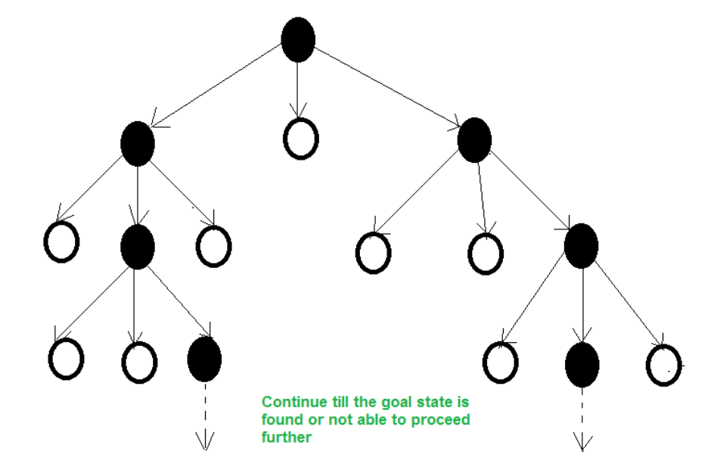
What is beam Search
A heuristic technique is a set of criteria for determining which of multiple options will be the most effective in achieving a particular goal.

Slide 149
Maximum Entropy Model
Intuitive Principle
Model all that is known and assume nothing about that which is unknown. Given a collection of facts, choose a model which is consistent with all the facts, but otherwise as uniform as possible.
Week 4, Lecture 3
9 / 16

Slide 150
Maximum Entropy: Overview
Suppose we wish to model an expert translator’s decisions concerning the proper French rendering of the English word ‘in’.

Slide 151
Maximum Entropy: Overview
Suppose we wish to model an expert translator’s decisions concerning the proper French rendering of the English word ‘in’.
Each French word or phrase f is assigned an estimate p(f ), probability that the expert would choose f as a translation of ‘in’.
Collect a large sample of instances of the expert’s decisions
Goal: extract a set of facts about the decision-making process (first task) that will aid in constructing a model of this process (second task)
Week 4, Lecture 3
10 / 16

Slide 152
Maximum Entropy Model: Overview
First clue: list of allowed translations
Suppose the translator always chooses among {dans, en, á, au cours de, pendant}.
First constraint: p(dans)+p(en)+p(á)+p(au cours de)+p(pendant) = 1. Infinite number of models p for which this identity holds, the most intuitive model?
allocate the total probability evenly among the five possible phrases →
most uniform model subject to our knowledge.
Is it the most uniform model overall? → No, that would grant an equal probability to every possible French phrase.
Week 4, Lecture 3
11 / 16

Slide 153
Maximum Entropy Model: Overview
More clues from the expert’s decision
Second clue: Suppose the expert chose either ‘dans’ or ‘en’ 30% of the time.

Slide 154
Maximum Entropy Model: Overview
More clues from the expert’s decision
Second clue: Suppose the expert chose either ‘dans’ or ‘en’ 30% of the time.
Third clue: In half of the cases, the expert chose either ‘dans’ or ‘á’
Week 4, Lecture 3
12 / 16

Slide 155
Maximum Entropy Model: Overview
More clues from the expert’s decision
Second clue: Suppose the expert chose either ‘dans’ or ‘en’ 30% of the time.
Third clue: In half of the cases, the expert chose either ‘dans’ or ‘á’
How do we measure uniformity of a model?
As we add complexity to the model, we face two difficulties: What exactly is meant by “uniform”?
How can one measure the uniformity of a model?
Week 4, Lecture 3
12 / 16

Slide 156
Maximum Entropy Modeling
Entropy: measures the uncertainty of a distribution.
Quantifying uncertainty (“surprise”)
Event x Probability p_{x}
Surprise: log(1/p_{x})
Week 4, Lecture 3
13 / 16

Slide 157
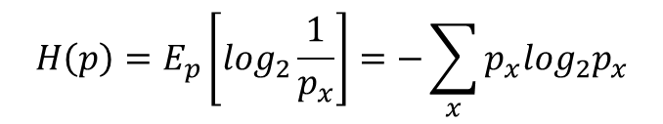
Maximum Entropy Modeling
Entropy: measures the uncertainty of a distribution.
Quantifying uncertainty (“surprise”)
Event x Probability p_{x}
Surprise: log(1/p_{x})
Entropy: expected surprise (over p)
$$H\left(p\right)=E_{p}\left[\log_{2}\frac{1}{p_{x}}\right]=−\sum_{x}{p_{x}\log_{2}p_{x}}$$
Week 4, Lecture 3
13 / 16

Slide 158
Maximum Entropy Modeling
Distribution required
Minimize commitment = maximize entropy Resemble some reference distribution
Solution
Maximize entropy H, subject to feature-based constraints:
E_{p}[f_{i}] = E_{˜p}[f_{i}]
Adding constraints
Lowers maximum entropy
Brings the distribution further from uniform and closer to data
Week 4, Lecture 3
14 / 16

Slide 159
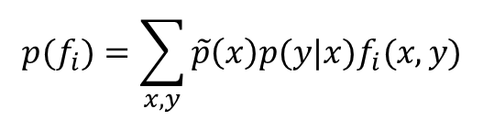
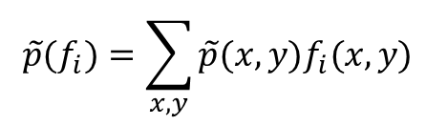
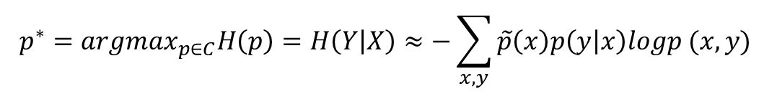
Maximum Entropy Principle
Given n feature functions f_{i}, we would like p to lie in the subset C of P defined by
C = {p ∈ P|p(f_{i}) = ˜p(f_{i}), i ∈ {1, 2, . . . , n}}
Empirical count (expectation) of a feature
$$\tilde{p}(f_{i})=\sum_{x,y}{\tilde{p}(x,y)f_{i}(x,y)}$$
Model expectation of a feature
$$p(f_{i})=\sum_{x,y}{\tilde{p}\left(x\right)p(y|x)f_{i}(x,y)}$$
Select the distribution which is most uniform (conditional probability):
$$p^{∗}={argmax}_{p∈C}H\left(p\right)=H\left(Y | X\right)≈−\sum_{x,y}{\tilde{p}\left(x\right)p\left(y | x\right)logp (x,y)}$$
Week 4, Lecture 3
15 / 16

Slide 160


Maximum Entropy Principle
p∗ = argmax_{p∈C}H(p)
Constraint Optimization
Introduce a parameter λ_{i} for each feature f_{i}. Lagrangian is given by
X
∧(p, λ) = H(p) + Σ λ
(p(f ) − ˜p(f ))
i i
i
i
Solving, we get


$$p_{λ}\left(y | x\right)=\frac{1}{Z_{λ}(x)}exp⁡(\sum_{i}{λ_{i}f_{i}(x,y))}$$
where Z_{λ}(x) is a normalizing constant given by


$$Z_{λ}\left(x\right)=\sum_{y}{exp\left(\sum_{i}{λ_{i}f_{i}(x,y)}\right)}$$
Week 4, Lecture 3
16 / 16

Slide 161

Practice Question
Consider the maximum entropy model for POS tagging, where you want to estimate P(tag|word). In a hypothetical setting, assume that tag can take the values D, N and V (short forms for Determiner, Noun and Verb). The variable word could be any member of a set V of possible words, where V contains the words a, man, sleeps, as well as additional words. The distribution should give the following probabilities
P(D|a) = 0.9
P(N|man) = 0.9 P(V|sleeps) = 0.9
P(D|word) = 0.6 for any word other than a, man or sleeps P(N|word) = 0.3 for any word other than a, man or sleeps P(V|word) = 0.1 for any word other than a, man or sleeps
It is assumed that all other probabilities, not defined above could take any values such that
.
$$\sum_{tag}{}$$
P(tag|word) = 1 is satisfied for any word in V.
Define the features of your maximum entropy model that can model this distribution. Mark your features as f1, f2 and so on. Each feature should have the same format as explained in the class. [Hint: 6 Features should make the analysis easier]
For each feature fi, assume a weight λi. Now, write expression for the following probabilities in terms of your model parameters
P(D|cat)
P(N|laughs)
P(D|man)
What value do the parameters in your model take to give the distribution as described above. (i.e.
P(D|a) = 0.9 and so on. You may leave the final answer in terms of equations)
Week 4, Lecture 4

Slide 162
Features for POS Tagging (Ratnaparakhi, 1996)
The specific word and tag context available to a feature is
hi = {wi, wi+1, wi+2, wi−1, wi−2, ti−1, ti−2}

Slide 163
Features for POS Tagging (Ratnaparakhi, 1996)
The specific word and tag context available to a feature is
hi = {wi, wi+1, wi+2, wi−1, wi−2, ti−1, ti−2}
Example: f_{j}(h_{i}, t_{i}) = 1 if suffix(w_{i}) = “ing“ & t_{i} = VBG

Slide 164

Example Features
Week 4, Lecture 4

Slide 165


Example Features
Week 4, Lecture 4
5 / 8

Slide 166
Search Algorithm
Conditional Probability
Given a sentence {w₁,..., w_{n}}, a tag sequence candidate {t₁, . . . , t_{n}} has conditional probability:
.
n
P(t , . . . , t |w . . . , w ) = Π p
(t |x )
1 n 1 n
i i
i=1
Week 4, Lecture 4
6 / 8

Slide 167
Search Algorithm
Conditional Probability
Given a sentence {w₁,..., w_{n}}, a tag sequence candidate {t₁, . . . , t_{n}} has conditional probability:
.
n
P(t , . . . , t |w . . . , w ) = p
(t |x )
1 n 1 n
i i
i=1
A Tag Dictionary is used, which, for each known word, lists the tags that it has appeared with in the training set.
Week 4, Lecture 4
6 / 8

Slide 168
Search Algorithm
Let W = {w₁,..., w_{n}} be a test sentence, s_{ij} be the jth highest probability tag
sequence up to and including word w_{i}. Search description
Generate tags for w₁, find top N, set s_{1j}, 1 ≤ j ≤ N, accordingly. Initialize i = 2
Initialize j = 1
Generate tags for w_{i}, given s_{(i−1)j} as previous tag context, and append each tag to s_{(i−1)j} to make a new sequence
j = j + 1, repeat if j ≤ N
Find N highest probability sequences generated by above loop, set s_{ij}
accordingly
i = i + 1, repeat if i ≤ n
Return highest probability sequence s_{n1}
Week 4, Lecture 4
7 / 8

Slide 169
Conditional Random Fields
CRFs are conditionally trained, undirected graphical models. Let’s look at the linear chain structure

Slide 170
Practice Question
Suppose you want to use a MaxEnt tagger to tag the sentence, “the light book”. We know that the top 2 POS tags for the words the, light and book are {Det, Noun}, {Verb, Adj} and {Verb, Noun}, respectively. Assume that the MaxEnt model uses the following history hi (context) for a word wi:
hi = {wi, wi−1, wi+1, ti−1}
where wi−1 and wi+1 correspond to the previous and next words and ti−1 corresponds to the tag of the previous word. Accordingly, the following features are being used by the MaxEnt model:
f1: ti−1 = Det and ti = Adj
f2: ti−1 = Noun and ti = Verb f3: ti−1 = Adj and ti = Noun f4: wi−1 = the and ti = Adj
f5: wi−1 = the&wi+1 = book and ti = Adj f6: wi−1 = light and ti = Noun
f7: wi+1 = light and ti = Det
f8: wi−1 = NULL and ti = Noun
Assume that each feature has a uniform weight of 1.0.
Use Beam search algorithm with a beam-size of 2 to identify the highest probability tag sequence for the sentence.
Week 4, Lecture 5

Slide 171
Problem with Maximum Entropy Models
Per-state normalization
All the mass that arrives at a state must be distributed among the possible successor states
This gives a ‘label bias’ problem
Let’s see the intuition (on paper)
Week 4, Lecture 5
3 / 8

Slide 172

Conditional Random Fields: Feature Functions
Week 4, Lecture 5

Slide 173

Feature Functions
Week 4, Lecture 5

Slide 174

Conditional Random Fields: Distribution
Week 4, Lecture 5

Slide 175
CRFs
Have the advantages of MEMM but avoid the label bias problem
CRFs are globally normalized, whereas MEMMs are locally normalized.
Widely used and applied. CRFs have been (close to) state-of-the-art in many sequence labeling tasks.
Week 4, Lecture 5

